Slide 1
Network Requirements for Resource Disaggregation
Peter Gao (Berkeley), Akshay Narayan (MIT), Sagar Karandikar (Berkeley), Joao Carreira (Berkeley), Sangjin Han (Berkeley),
Rachit Agarwal (Cornell), Sylvia Ratnasamy (Berkeley), Scott Shenker (Berkeley/ICSI)

Slide 2
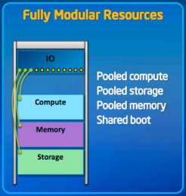
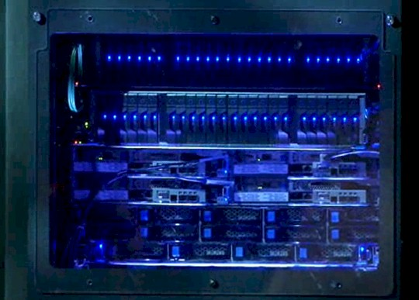
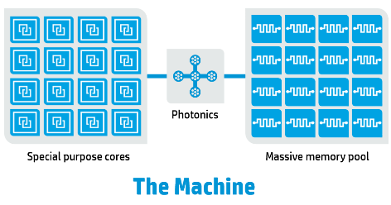
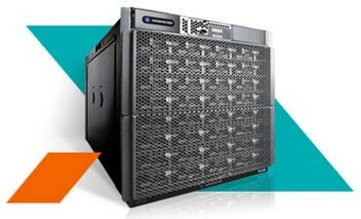
Disaggregated Datacenters
Current Datacenter: Server-Centric
Future datacenter: Disaggregated?
Datacenter Network
Datacenter Network
HP – The Machine
Intel - RSD
Facebook
GPU
GPU
GPU
GPU
Huawei - NUWA
SeaMicro
Berkeley - FireBox

Slide 3
Disaggregation Benefits (Architecture Community)
Overcome memory capacity wall
Higher resource density
Simplify
Hardware
Design
Relax
Power & Capacity
Scaling

Slide 4
Network is the key
Server-Centric
Disaggregated
Network
GPU
GPU
Do we need specialized hardware?
e.g.: Silicon photonics, PCI-e
Network
GPU
GPU
QPI, SMI, PCI-e
Existing prototypes use specialized hardware, such as Silicon Photonics, PCI-e

Slide 5
Application
Remote Resource
Current OS and network stack are not
(Solutions are feasible)
Transport
✘
Transport
Transport
Transport
OS
OS
OS
OS
✔
Commodity hardware solutions may be sufficient
NIC
NIC
NIC
NIC
Switch
Switch
What end-to-end latency and bandwidth must the network provide for legacy apps?
Do existing transport protocols meet these requirements?
Do existing OS network stacks meet these requirements?
Can commodity network hardware meet these requirements?
Worst case performance degradation

Slide 6
Assumptions
Cache Coherence
CPU
Memory
Storage
Scale
Limited cache coherence domain
Small amount of local cache (how much?)
Page-level remote memory access
Datacenter Network
Block-level distributed data placement
Rack-scale?
Datacenter-scale?

Slide 7
Latency and Bandwidth Requirements
Workloads
Applications
Methodology: Workload Driven
10 workloads on 8 applications
~ 125 GB input data
5 m3.2xlarge EC2 nodes
Virtual Private Cloud enabled
Wordcount
Spark
Hadoop
Batch Processing
Sort
Pagerank
Timely Dataflow
Collaborative Filter.
Graphlab
Key-value Store
Memcached
HERD
Interactive
SQL
Spark SQL
Streaming
Spark Streaming

Slide 8
Disaggregated Datacenter Emulator
OS
Special Swap Device (Handles Page Fault)
Backed by the machine’s own memory
Partition the memory into local and remote
Memory
Local RAM
Emulated Remote RAM
Free to access
Via swap device
Inject latency and bandwidth constraints
Using special swap device
Delay = latency + request size / bandwidth
Akin to a dedicated link between CPU and memory

Slide 9
Latency and Bandwidth Requirement
100 Gbps
40 Gbps
10 Gbps
100 Gbps
40 Gbps
10 Gbps
100 Gbps
40 Gbps
10 Gbps
5% degradation
~3us latency / 40Gbps bandwidth is enough, ignoring queueing delay
1us
5us
10us
5% degradation
*Note: Delay = latency + request size / bandwidth

Slide 10
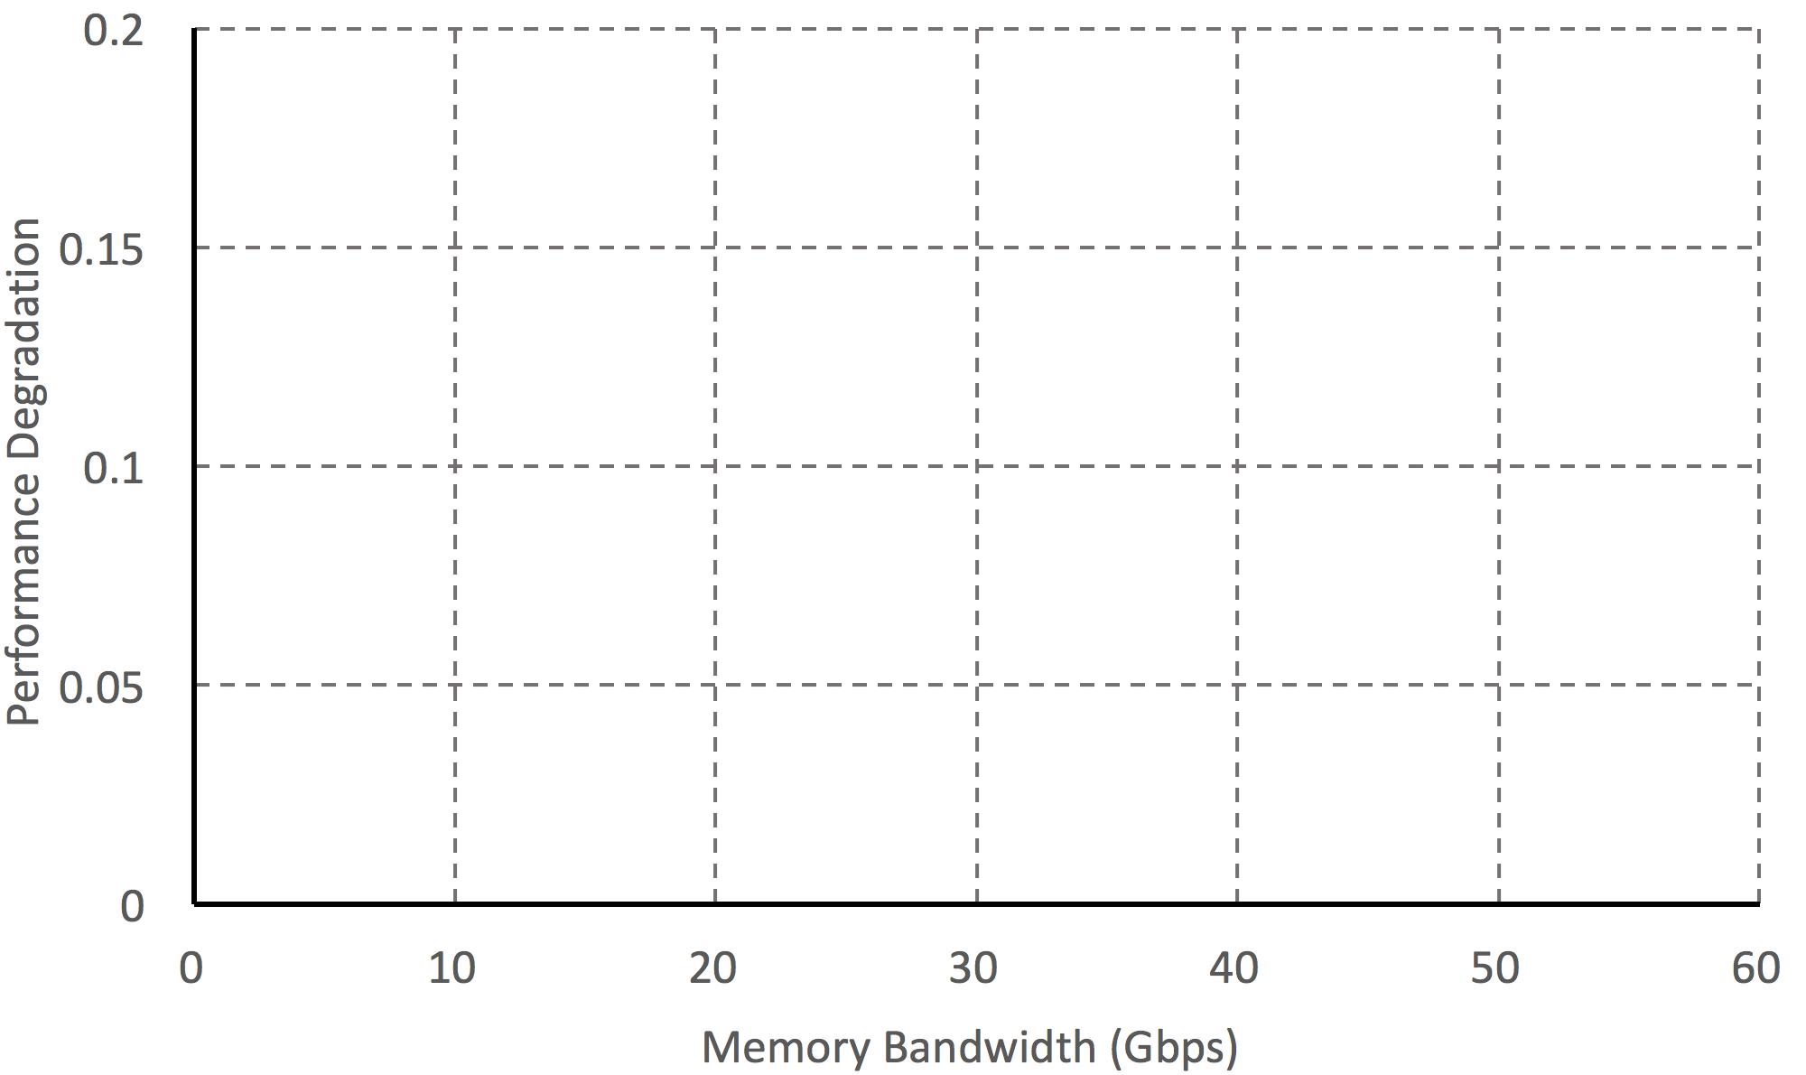
Understanding Performance Degradation
Spark
Wordcount
SparkSQL
BDB
Performance degradation is correlated with application memory bandwidth
HERD
YCSB
Timely
Pagerank
Spark
Sort
Graphlab
CF
Hadoop
Sort
Memcached
YCSB
Hadoop
Wordcount
Spark Streaming
Wordcount

Slide 11
3us end-to-end latency
40Gbps dedicated link (no queueing delay)
Remote Resource
Application
Remote Resource
Application
Transport
Transport
OS
OS
NIC
NIC
Switch

Slide 12
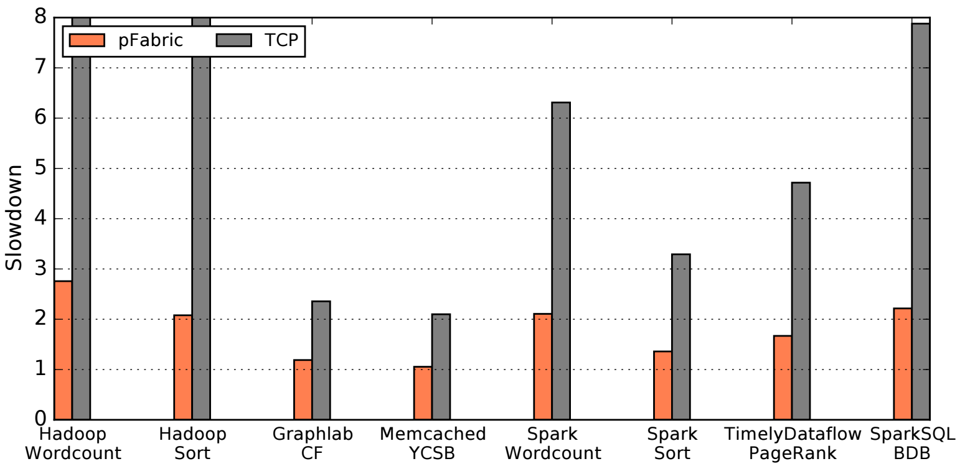
Transport Simulation Setting
Special Swap Instrumentation
Flow Trace
Network Simulator
Flow completion time distribution
Need new transport protocols

Slide 13
Application Performance Degradation
40Gbps (no queueing delay)
DC Scale (with queueing delay)
Rack Scale (with queueing delay)
40Gbps
network
~5% degradation
100Gbps network
DC scale for some apps, rack scale for others
100Gbps (no queueing delay)
DC Scale (with queueing delay)
Rack Scale (with queueing delay)
100Gbps
network
~5% degradation

Slide 14
3us end-to-end latency
40Gbps dedicated link
Application
Remote Resource
Efficient Transport
100Gbps network
Transport
Transport
Transport
Transport
OS
OS
NIC
NIC
Switch

Slide 15
Is 100Gbps/3us achievable?

Slide 16
Feasibility of end-to-end latency within a rack
Propagation
Transmission
Switching
Data Copying
OS
Application
Remote Resource
3us Target
1.9us
0.32us
0.8us
2us
*Numbers estimated optimistically based on existing hardware

Slide 17
Feasibility of end-to-end latency within a rack
Propagation
Transmission
Switching
Data Copying
OS
Application
Remote Resource
3us Target
1.9us
0.32us
0.8us
2us
Propagation
Cut-through Switch
Switching
Data Copying
OS
Transmission
Application
Remote Resource
0.32us
0.48us
1.9us
0.8us
2us
*Numbers estimated optimistically based on existing hardware

Slide 18
Feasibility of end-to-end latency within a rack
Propagation
Transmission
Switching
Data Copying
OS
Application
Remote Resource
3us Target
1.9us
0.32us
0.8us
2us
Cut-through Switch
NIC Integration
OS
Data Copying
Application
Remote Resource
0.32us
0.48us
2us
1.9us
1us
*Numbers estimated optimistically based on existing hardware

Slide 19
Feasibility of end-to-end latency within a rack
Propagation
Transmission
Switching
Data Copying
OS
Application
Remote Resource
3us Target
1.9us
0.32us
0.8us
2us
Feasible to meet target across the datacenter?
Cut-through Switch
OS
NIC Integration
Use RDMA
Application
Remote Resource
3us Target
1.9us
0.32us
0.48us
1us
*Numbers estimated optimistically based on existing hardware

Slide 20
3us end-to-end latency
40Gbps dedicated link
Efficient Transport (pFabric,SIGCOMM’13, pHost,CoNEXT’15)
100Gbps network (Available)
Remote Resource
Application
Remote Resource
Application
Transport
Transport
Transport
Transport
Kernel bypassing (RDMA common)
OS
OS
OS
OS
NIC
NIC
NIC
NIC
Switch
Switch
CPU-NIC Integration (Coming soon)
Cut-through switch (Common?)
100Gbps links (Available)

Slide 21
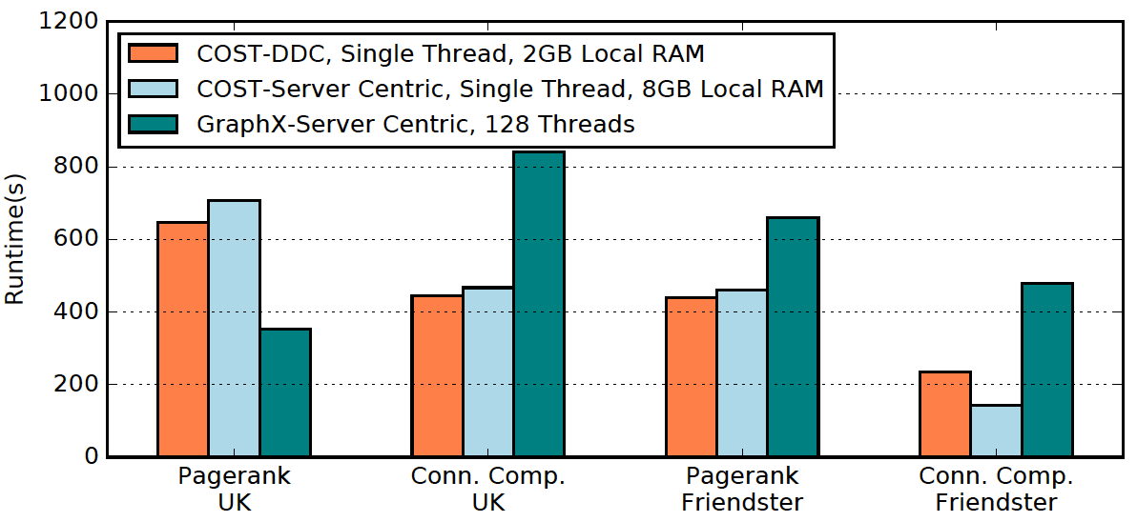
What’s next?
Application Design
Rethinking OS Stack
Storage
Network Stack
Failure Models
Please refer our paper for evaluations on improving application performance in disaggregated datacenters
Network Fabric Design

Slide 22
Thank You!
Peter X. Gao
Akshay Narayan
Sagar Karandikar
Joao Carreira
Sangjin Han
Rachit Agarwal
Sylvia Ratnasamy
Scott Shenker

Slide 23
Discussion Points
Scheduler Design in a disaggregated server
Rack Scale vs Data center scale
Applications with even higher memory bandwidth requirement?
Performance degradation is ok, what about energy?
Future of servers with specialization – FPGAs, ASICs
Security concerns of disaggregation.

